Slide 1

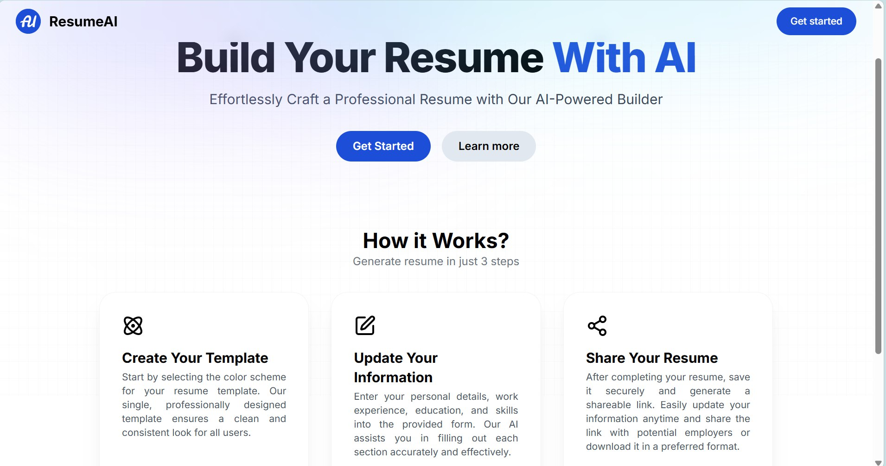
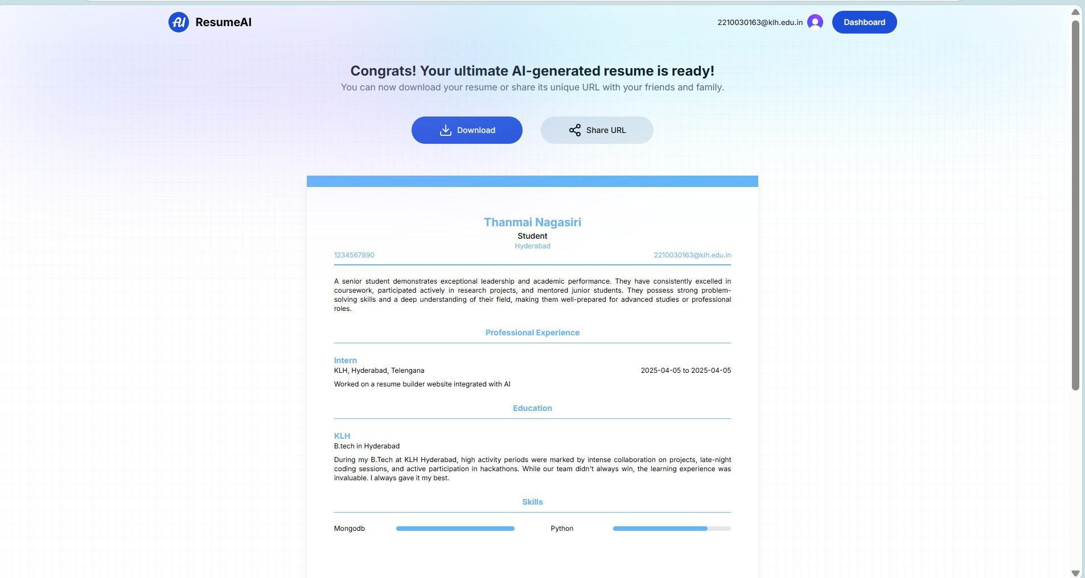
Koneru Lakshmaiah Education Foundation, Hyderabad(Aziz Nagar,Off Campus)
ONLINE RESUME BUILDER
VEMPATI THANMAYEE, ITARAJU KAVYA PRIYA,V.THANMAI NAGA SIRI,T.TANISWI
Department of Computer Science and Engineering, Koneru Lakshmaiah Education Foundation, Hyderabad-500075, Telangana, India.
Abstract
Methods and Materials
Discussion
An online resume builder simplifies the process of creating professional resumes using a user-friendly interface. Leveraging enterprise programming frameworks, it provides robust, scalable, and secure solutions to handle multiple users simultaneously. Features like drag-and-drop sections, pre-designed templates, and real-time formatting ensure a seamless experience for users of all skill levels.
The platform also facilitates multi-device compatibility, allowing users to create, edit, and download resumes on the go which is also free of cost. Enterprise programming ensures efficient back-end processing, maintaining high performance and reliability. It enhances the resume’s relevance in today’s competitive job market.
In developing the Resume Builder, an Agile methodology was adopted to prioritize adaptability and rapid user feedback. This iterative approach allowed the frontend team to continuously refine the user interface based on real-time testing and evolving requirements (Beck et al., 2001). Collaboration among developers, designers, and career consultants ensured the platform was both visually appealing and functionally intuitive.
The frontend was built using React.js, a powerful JavaScript library for building component-based UIs. React’s virtual DOM and one-way data flow enabled efficient rendering and better performance (Facebook, 2013). The application structure leveraged reusable components to promote maintainability and scalability.
Standard web technologies like HTML5, CSS3, and JavaScript (ES6+) were used for markup, styling, and functionality. Styling was further enhanced using responsive design principles and component-level CSS. Additional functionality was provided through third-party libraries and APIs to enrich the user experience — such as form validation, dynamic resume previews, and export options.
Version control was managed using Git, ensuring smooth collaboration and continuous integration during the development lifecycle.
Resume Builder is an easy-to-use platform that helps users create professional resumes quickly. With features like drag-and-drop templates and AI suggestions, it simplifies the resume-building process. It also optimizes resumes with keyword tips to improve job search chances. Users can customize resumes with various templates and design options to suit their needs. The platform provides real-time feedback, helping users improve their resume content instantly. Overall, it makes resume creation fast, easy, and effective for job seekers. It helps users save time, optimize their resumes, and increases their chances of landing a job.
Introduction
Results
Conclusions
Resume Builder is a cutting-edge platform designed to transform the way resumes are created and managed. Built with the power of enterprise programming, Resume Builder caters to job seekers and professionals seeking a seamless resume-building experience.
Tailored for the digital age, Resume Builder offers an intuitive interface with features like drag-and-drop sections, pre-designed templates, and real-time formatting. Every functionality is carefully crafted to ensure users can create professional resumes effortlessly and effectively.
Resume Builder is built to work smoothly and fit modern job-hunting needs. Whether you are a student or an experienced professional, it helps you create resumes that showcase your skills and achievements. Its simple design and helpful features save time while ensuring your resume looks polished and professional. It’s a simple and helpful tool to improve your job search.
The results of Resume Builder's implementation have been highly successful, with users reporting a significant improvement in the ease and speed of resume creation. Job seekers have expressed greater confidence in their resumes, thanks to the platform’s personalized suggestions and customizable templates. Users also noted the platform's intuitive interface and seamless experience across devices, making it easy to create, edit, and download resumes on-the-go. As a result, Resume Builder has shown strong potential in simplifying the job application process, helping users craft resumes that stand out in competitive job markets.
Moreover, the platform's integration of AI-powered features for keyword optimization and real-time feedback has been well-received. These features not only enhance resume quality but also improve job search effectiveness by tailoring resumes to specific job requirements. Improving the quality of resumes and making them more likely to catch employers' attention. Many users have reported more confidence in their resumes due to the platform’s personalized suggestions and easy-to-use templates Resume Builder’s focus on user feedback and regular updates ensures it stays ahead, providing a valuable tool for job seekers. The ability to create and edit resumes from any device has made it more convenient for job seekers. Overall, Resume Builder has made the job application process simpler, helping users create resumes that stand out.
In conclusion, Resume Builder is a powerful and efficient tool for job seekers, offering an intuitive and customizable platform to create professional resumes. With its ease of use and flexible design options, the platform simplifies the resume-building process and increases users' chances of success. Resume Builder is an essential resource for anyone looking to create a polished and impactful resume quickly and effectively.
This project represents a significant step towards empowering job seekers by providing them with the tools needed to present themselves professionally in today's competitive job market.
Future Directions
In the future, Resume Builder aims to further enhance the resume-building experience through AI-driven features and data analytics. Optimization for mobile devices will ensure that users can create and edit resumes on the go. Integration with job portals will simplify the application process by allowing users to upload their resumes directly. Collaborative features will be introduced, enabling users to share their resumes for feedback. Accessibility improvements will ensure that the platform remains inclusive and easy to use for all job seekers.
Contact Information
References
Acknowledgements
V.Thanmayee
2210030072@klh.edu.in
https://agilemanifesto.org
https://reactjs.org
We would like to thank the following people for their support and guidance without whom the completion of this project in fruition would not be possible. Dr. Pavan Kumar Pagadala, our project guide, for helping us and guiding us in the course of this project. Dr. Arpita Gupta, the Head of the Department, Department of CSE. Our internal reviewers, Dr Trinath Basu, for their insight and advice provided during the review sessions. We would also like to thank our individual parents and friends for their constant support.

